Slide 1
SMART AIR QUALITY
IoT MONITOR
ESP32 • Environmental Sensors • Live Dashboard • Alerts
PROJECT PRESENTATION

Slide 2
01 | Introduction
Why monitor air quality?
Air pollution can affect human health and the environment.
A monitoring system measures key air-quality indicators.
IoT makes readings easier to view and share in real time.
PROJECT GOAL
Build an affordable connected monitor that displays environmental readings and alerts users when configured thresholds are exceeded.
02 / 05

Slide 3
02 | Components & System
Main hardware and software
ESP32
PMS9103M
Controller + Wi-Fi
Particulate matter: PM1.0, PM2.5, PM10*
MQ-135
DHT11
Gas / air-quality response*
Temperature + humidity
LCD + LEDs + buzzer
Web dashboard / Telegram
Local readings and alerts
Remote monitoring and notifications
*Sensor readings need suitable calibration; MQ-135 is not a certified AQI instrument.
03 / 05

Slide 4
03 | Working Principle
From sensor readings to useful information
1
2
3
4
SENSE
PROCESS
DISPLAY
ALERT
Sensors collect particulate, gas-response, temperature and humidity data.
The ESP32 reads the sensors and applies the programmed logic.
The LCD and web dashboard show the latest measurements.
LEDs, buzzer or Telegram notifications can indicate configured limits.
Important: sensor outputs are not automatically official AQI values. AQI calculation requires appropriate pollutant measurements, calibration and the applicable CPCB method.
04 / 05

Slide 5
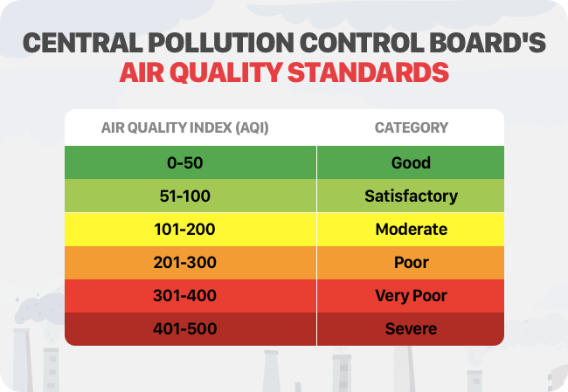
04 | CPCB Air Quality Standards
AQI categories shown in the supplied reference image
AQI CATEGORIES
Good: 0–50
Satisfactory: 51–100
Moderate: 101–200
Poor: 201–300
Very Poor: 301–400
Severe: 401–500
Note: these are the categories in the supplied image; sensor values from this prototype should not be presented as official CPCB AQI without validated measurements and calculation.
05 / 05

